Slide 1
Analysis of the Health Care Agency in the Healthcare Industry
Student’s Name
Course name and course number
Due date
Faculty member's name

Slide 2
Introduction
The presentation will begin with the discussion of healthcare agency, which is HRSA.
The website and appropriate artifact for HRSA will be provided
The next section will give one healthcare regulation in the healthcare industry
The website and an artifact for the regulation will be provided
The final section will entail the conclusion of the discussions.
Notes:
The healthcare industry is an important industry as it helps in ensuring that the entire society gets access to healthcare services, which helps in keeping the community healthy at all times. In this case, some of the important aspects that helps in maintaining professionalism and safety of patients are the healthcare agencies and healthcare regulations. This presentation will outline an example of healthcare agency and regulations in the US healthcare industry. The presentation will give the websites for the agency and regulation, as well as an artifact for each. The impact of each will be discussed, with the final section giving the conclusion.

Slide 3
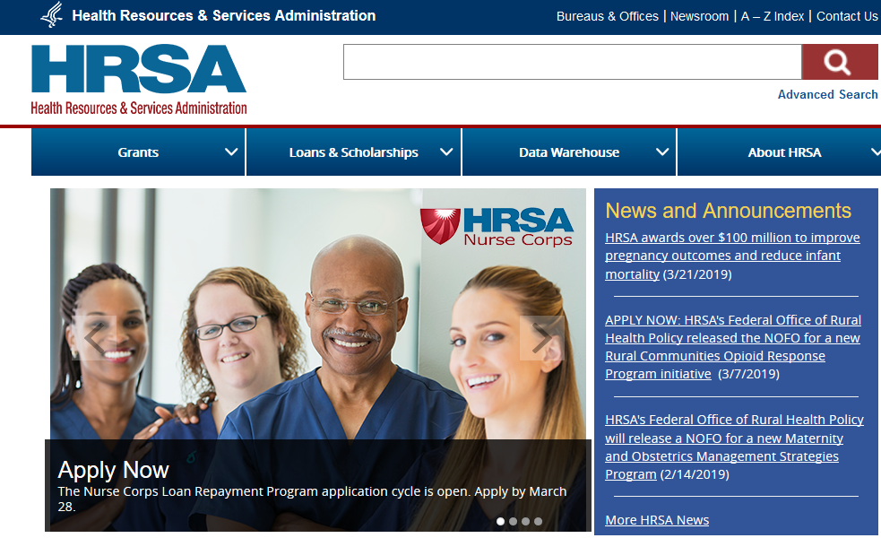
The Health Resources and Services Administration (HRSA)
HRSA is an agency of the U.S. Department of Health and Human Services.
HRSA’s website can be accessed at https://www.hrsa.gov/
The following s an artifact representing HRSA’s website
Notes:
The health Resource and Services Administration is an agency of the US Department of Health and Human Services. HRSA programs provide health care to people who are geographically isolated, economically, or medically vulnerable. This includes people living with HIV/AIDS, pregnant women, mothers, and their families, and those otherwise unable to access high quality health care. HRSA also supports access to health care in rural areas, the training of health professionals, the distribution of providers to areas where they are needed most, and improvements in health care delivery. For more information concerning HRSA, one can access its websites at https://www.hrsa.gov/

Slide 4
The Health Resources and Services Administration (HRSA)
HRSA is the primary federal agency for improving health care to people who are geographically isolated, economically or medically vulnerable.
HRSA also supports the training of health professionals, the distribution of providers to areas where they are needed most and improvements in health care delivery
A healthcare structure that must comply with the HRSA is a health center
The HRSA has led to improvement in the accessibility of healthcare to the US citizens, with more than 27 million relying on a HRSA-funded health center for affordable, accessible primary care.
Notes:
HRSA is the primary federal agency for improving health care to people who are geographically isolated, economically or medically vulnerable. The agency further helps in the healthcare industry by providing training of health professionals, the distribution of providers to areas where they are needed most and improvements in health care delivery. Currently the HRSA is an agency that overseas all of the healthcare centers in the US. In this case, a healthcare facility that must comply with the agency is a healthcare center. As a result of its continued support to the healthcare industry in the US, HRSA has led to improvement in the accessibility of healthcare to the US citizens, with more than 27 million relying on a HRSA-funded health center for affordable, accessible primary care.

Slide 5
Healthcare Regulation
One of the regulations affecting the delivery of healthcare services in the healthcare industry is the HIPPA Privacy Rule
The Rule requires appropriate safeguards to protect the privacy of personal health information, and sets limits and conditions on the uses and disclosures that may be made of such information without patient authorization
The Privacy Rule is located at 45 CFR Part 160 and Subparts A and E of Part 164
The rule can be accessed via https://www.hhs.gov/hipaa/for-professionals/privacy/index.html
Notes:
Healthcare industry is very delicate as it deals with the health of both humans and animals (). In this regard, rules and regulations are required to ensure that participants in the industry maintain highest degree of professionalism. One of the regulations that is guiding the healthcare industry is the HIPPA Privacy Rule. This rule is located at 45 CFR Part 160 and Subparts A and E of Part 164. the HIPPA Privacy Rule requires appropriate safeguards to protect the privacy of personal health information, and sets limits and conditions on the uses and disclosures that may be made of such information without patient authorization. As such, the rule is aimed at ensuring that all information of a patient does not fall in unauthorized hands.

Slide 6
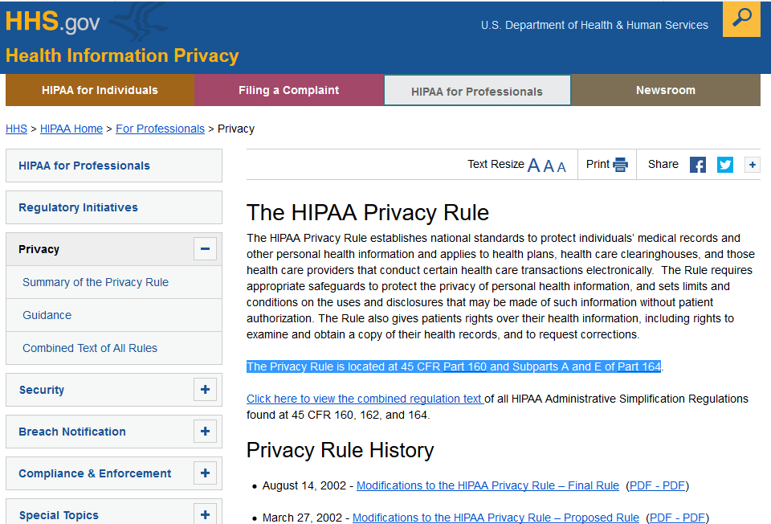
Healthcare Regulation
The artifact showcasing HIPPA Privacy rule is shown below

Slide 7
Healthcare Regulation
The HIPPA Privacy rule is carried out at both federal, state and local level.
All healthcare providers are expected to comply with this regulation. Therefore, an example of a structure required to comply with this regulation is a hospital.
The regulation has led to the protection of individual and personal medical information, in turn leading to trust among patients towards healthcare providers. The overall impact is the improved quality of healthcare services.
Notes:
Since the HIPPA Privacy Rule was aimed at protecting all patients in the US, the rule is carried out at both federal, state and local level (Cohen & Mello, 2018). The rule requires any healthcare provider, irrespective of the level or the post, to comply with the HIPPA Privacy rule. Consequently, the rule must be followed by all healthcare providers and structures in the US. An example of the structure to follow the HIPPA Privacy Rule is a hospital. HIPPA Privacy Rule has led to the protection of individual and personal medical information, in turn leading to trust among patients towards healthcare providers. The overall impact is the improved quality of healthcare services (Cohen & Mello, 2018).

Slide 8
Conclusion
Healthcare agencies are important in the healthcare industry as they help in ensuring that the provision of healthcare is professional.
HRSA is the primary agency of the U.S. Department of Health and Human Services.
The agency has led to the creation of affordable healthcare system to more than 27 million US citizens.
HIPPA Privacy rule is a regulation requiring healthcare providers to maintain privacy of the medical records of their patients, hence promoting professionalism and trust in the healthcare industry.
Notes:
Healthcare agencies are essential in the industry as they help in ensuring that healthcare services are provided in the most professional manner and that healthcare is accessible to all groups of the society. This presentation has discussed the HRSA agency, which is the primary agency of the U.S. Department of Health and Human Services. From the discussion, the agency has led to improvement in the healthcare services in the country, with more than 27 million Americans getting access to affordable and high-quality healthcare services from the HRSA-funded health centers. The presentation has also discussed the HIPPA Privacy regulation, which has been shown as a regulation requiring healthcare providers to maintain privacy of the medical records of their patients, hence promoting professionalism and trust in the healthcare industry.

Slide 9
References
US DHHS. (2019). HIPPA Privacy Rule. Retrieved from https://www.hhs.gov/hipaa/for-professionals/privacy/index.html
Cohen, G. & Mello, M. M. (2018). HIPAA and Protecting Health Information in the 21st Century. JAMA, 320 (3): 231-232
Washko, M. M., & Fennell, M. L. (2017). The Epicenter of Effectiveness and Efficiency in Health Care Delivery: The Evolving U.S. Health Workforce. Health services research, 52 Suppl 1(Suppl Suppl 1), 353-359.
HRSA. (2019). Agency Overview. Retrieved from https://www.hrsa.gov/sites/default/files/hrsa/about/hrsa-agency-overview.pdf

